Slide 1

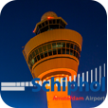


Slide 2
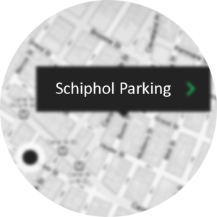
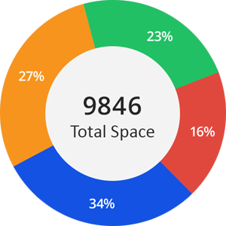

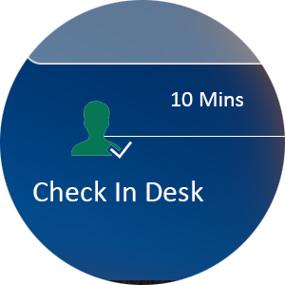
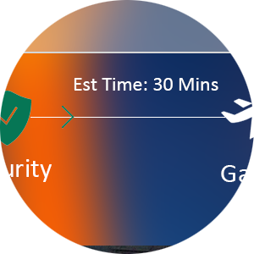
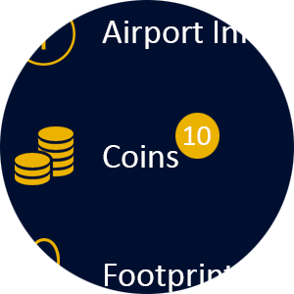


Smart sensor will help us to find the free parking space in their mobile.
Find My Car – Don’t get last when you back from vacation.
The data collected from smart parking system help to forecast future business
Athena App guides the passenger through out journey – Check-in, bag drop-off, security gate,
passport control and gate.
Real time data about queuing helps passenger spend his/her effective time in shopping plaza
Parking
Real Time
Gamification
Rewarding system through which passenger can collect coins and later reclaim in stores.
Location based AD
Through which agency can advertise directly passenger right through our mobile app in turn
it can generate more revenue.
Physically Challenged
Assistance for physically challenged people.

